Slide 1



Bachelor of Science in Environmental Sciences
Academic Orientation
Fall 2026
Your Host:
Carie Devitt
Academic Advisor

Slide 2
Goals of this Meeting
Meet YOUR B.Sc.(Env.) Academic Advisor - Carie
Review important dates
B.Sc.(Env.) program information
Special Guests - Meet upper year B.Sc.(Env.) students
Find out about resources available on campus and how to contact Carie ☺

Slide 3
Meet Carie ☺
Carie Devitt – Academic Advisor for all students in B.Sc.(Env.)
(she/her)
First point of contact for B.Sc.(Env.) program information
General policy help – making sense of the University RULES
Course schedule difficulties
Missed class time or exams (academic consideration)
Graduation Requirements
Never hesitate to ask for help!

Slide 4

Important Dates
Last day to add classes or change course sections for F26 is September 18th
Last day to drop classes for F26 is the last class day – December 4th
Schedule of dates is in the current Undergraduate Calendar – stay on top of dates!
Classes start this Thursday September 10th - Do NOT miss any classes!

Slide 5
What Major am I In?
…and other Program Information
Bachelor of Science in Environmental Sciences Degree Program aka B.Sc.(Env.)
Four-year, honours degree (five years with co-op)
Undeclared major (for now!)
Can I minor? Yes! …but most B.Sc.(Env.) students do NOT minor
In co-op? Register for COOP1100 in W27; Sequence of co-op work terms will depend on which major you declare; If NOT in co-op and intend to apply, do it by the last day of class in fall – that’s a hard deadline!
Five majors to choose from:
  Earth Observation Geographic Information Science
  Ecology
  Environmental Economics and Policy
  Environmental Sciences
  Environment and Resource Management

Slide 6
Faculty Advisors
Faculty Advisors:
  Earth Observation Geo Info Science -
  Ecology – Dr. Ryan Norris
  Environmental Sciences – Dr. James Longstaffe
  Environmental Economics and Policy – Dr. Brady Deaton
  Environment and Resource Management – Dr. Ze’ev Gedalof
Meeting for Majors…to be continued!
  I will host a meeting to find out more about the five majors in early Winter semester before you need to declare (watch for an email from me)

Slide 7
Professors’ Expectations
Responsibilities
It’s up to you to seek out the information you need.
Help is available, but you NEED TO ASK
No one will chase down your assignments
If you hand something in late, you will lose marks. Not at all? You’ll get 0.
Deadlines
Ask instructors if you need mid-semester academic consideration for:
medical
psychological or
compassionate
grounds.
Learning expectations
Clearly laid out in
COURSE OUTLINES.
Carie’s TIP
Print them.
Put dates on a calendar.
Go to class.
You can skip seminars and labs and lectures and no one will notice!
Yikes!

Slide 8
General Survival Tips
Ask for help
I can’t emphasize this enough.
Download Outlook on your phone
Courselink - search ‘Courselink’ on the University of Guelph website www.uoguelph.ca
Instructors can help you IF you ask!
Become familiar with the academic policies!
Save Course Outlines
Check and use your @uoguelph.ca email
Check your program on WebAdvisor (coop vs non coop) and your timetable
Know what the Undergraduate Calendar is and how to find it.

Slide 9
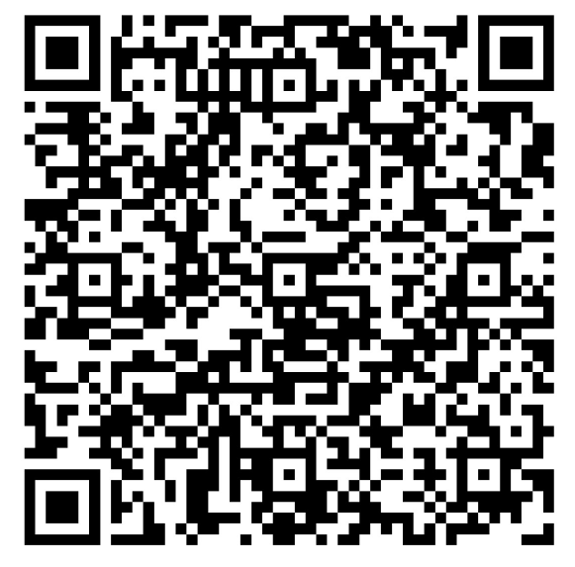
Get to know your degree requirements early on!
The Student Planning System on WebAdvisor shows you personalized academic requirements for your degree. Summarized for you specifically, including what you have taken and what you still need to take according your schedule of studies (once you declare your major).
Your schedule of studies is the list of the courses you need to take to complete your degree. The schedule of studies is broken down by major and lists core courses, major specific courses and restricted electives you can choose from for your major (once you declare your major).
Program information (like the rule that you cannot count more than 7.0 credits at the 1000 level toward the minimum 20 academic credits required for your degree) AND the schedule of studies for each of the majors in B.Sc.(Env.) can be found in the Undergraduate Calendar. Spoiler alert: You will need this for one of your first-semester course assignments.
B.Sc.(Env.)

Slide 10
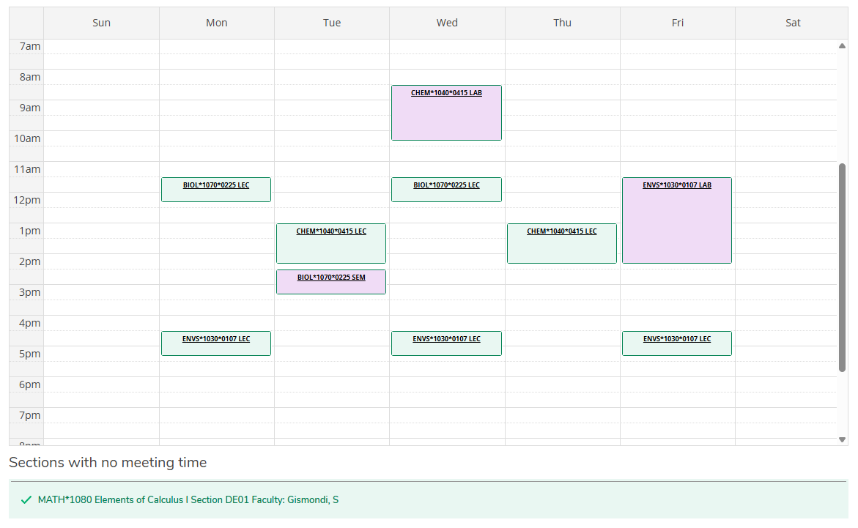
My Progress and Viewing your FALL Schedule on WebAdvisor

Slide 11
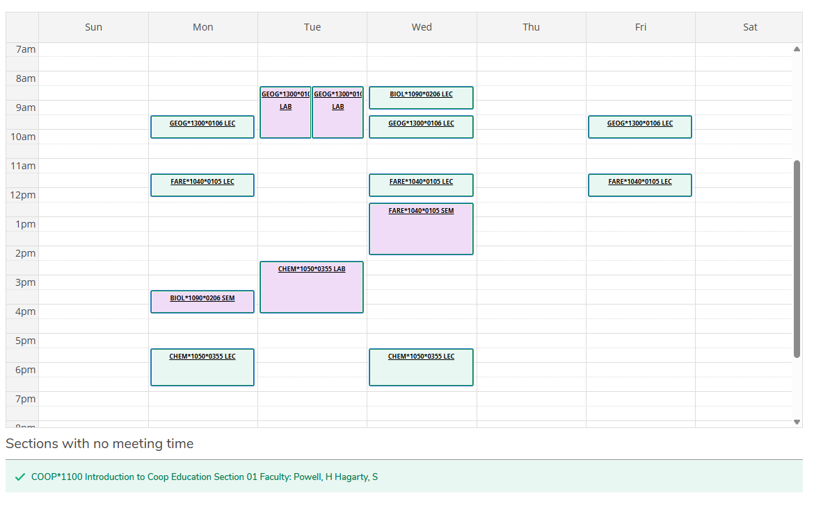
My Progress and Viewing your WINTER Schedule on WebAdvisor

Slide 12

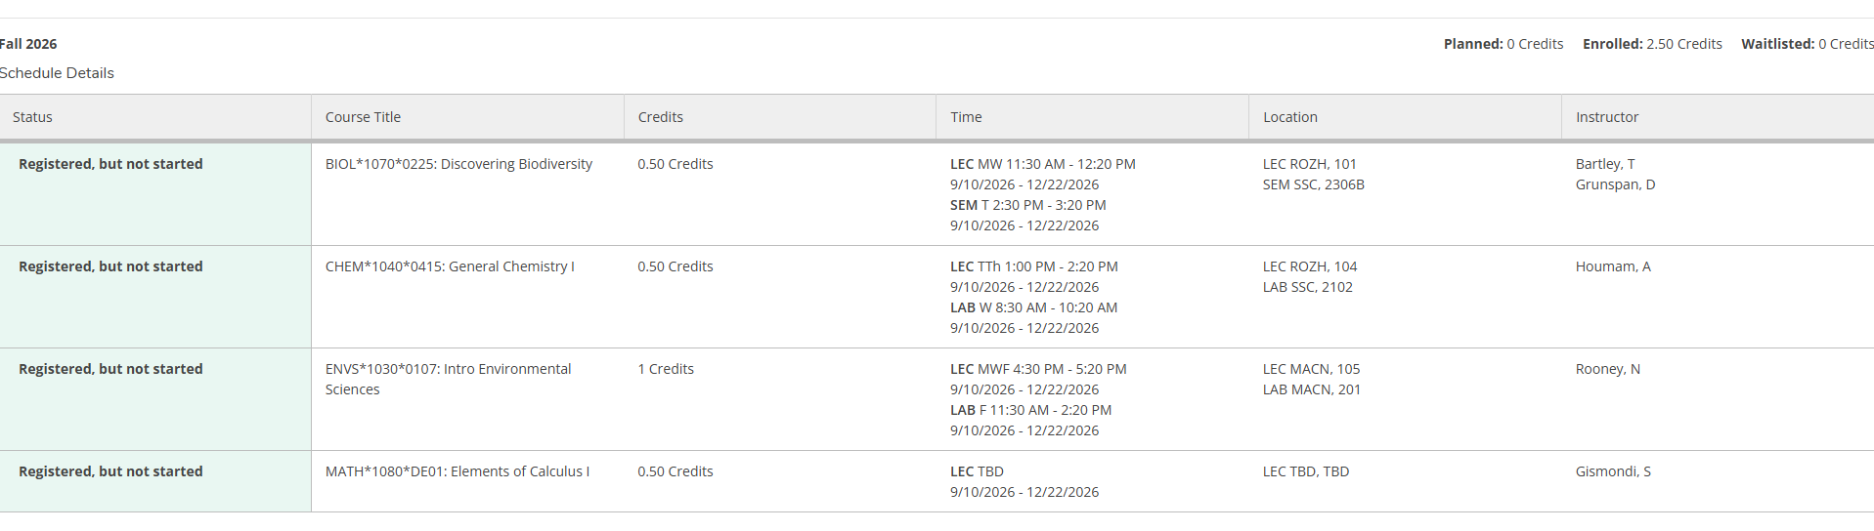
Schedule Print Button in WebAdvisor
This is the best way to double check and confirm that you are registered!

Slide 13
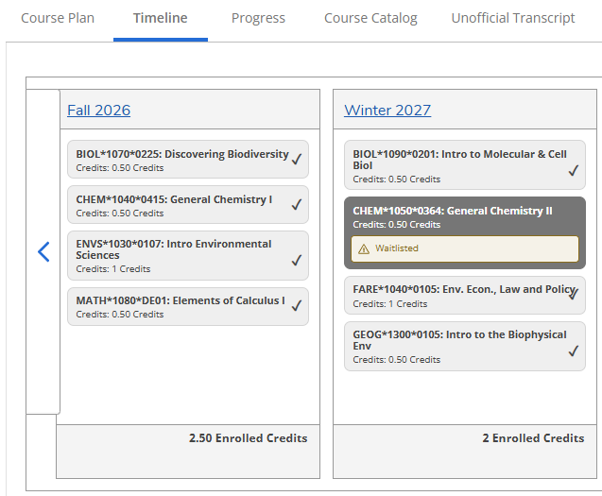
Timeline in WebAdvisor
Keep it cleaned up
Waitlists… what you need to know

Slide 14
Why is the University Structure so Confusing?
What are Colleges?
University is founded on colleges including OAC. Every student in B.Sc.(Env.) comes in undeclared and starts out under the college of OAC.
All Programs/Majors are associated with colleges. Two of the B.Sc.(Env.) majors are under the college of OAC and two are not. My office is in the OAC Program Counselling office, but I help students in all five majors regardless of affiliated college. That’s all you really need to know!
Some scholarships/bursaries are associated with colleges so it’s good to have an awareness of your college both now and once you declare a major.

Slide 15
What do all of the acronyms mean?
OAC is Ontario Agricultural College
  The college you are associated with for now. CSAHS and CBS are the other colleges associated with majors in your degree program.
B.Sc.(Env.) is your degree program
  Note it is NOT B.Sc.
SAS is Student Accessibilities Services
  Offers services for students requiring accommodations
SLG is Supported Learning Groups
  Small group learning environments for select courses offered by the Library
TA is Teaching Assistant
  Work with instructors to help students with specific course
  ESSE is the Environmental Science Student Executive
  Your college student government, representing students in your degree program

Slide 16
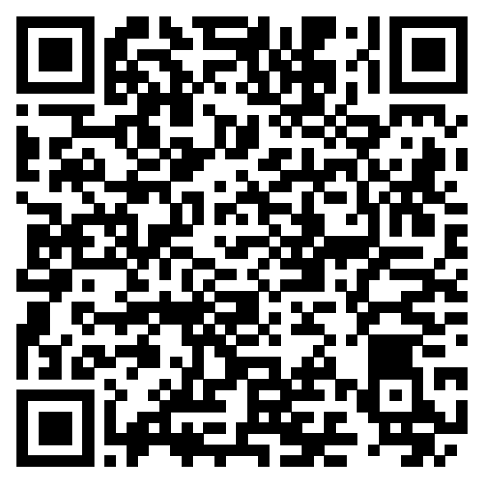
Hear from Upper Year Students ☺
A message from your
ESSE President:
McKenzie
esse@uoguelph.ca
LOUNGE:
Alexander Hall Room 266
ENVIRONMENT STUDENT Mentorship program
Pro tips for first year courses…

Slide 17
A message from your SFOAC rep Shaylen!
Being a part of the OAC is something truly special. It comes with incredible opportunities, lifelong friendships, and of course a whole lot of fun! No matter what your interests are, there is something for everyone within the OAC community. I encourage each of you to get involved and explore everything that the OAC has to offer.
Whether it’s joining a new club, competing on a Tractor Tug team or attending the OAC Leadership Conference, you’re bound to find something that sparks your interest. During your time in Guelph, you’ll become part of a supportive network of students and alumni who are always willing to help you throughout your schooling and future career.
The friendships and connections you build here are truly special and can last a lifetime. With that being said be sure to follow the OAC Class of 2030 Aggies on Facebook and keep an eye out for upcoming events, club meetings and opportunities to get involved.

Slide 18

How to find Carie…
Johnston Hall Room 133A
Email Carie at bscenvpc@uoguelph.ca to book a virtual or in-person appointment
F26 Weekly DROP IN hours Wednesdays 10 am - 12 pm

Slide 19
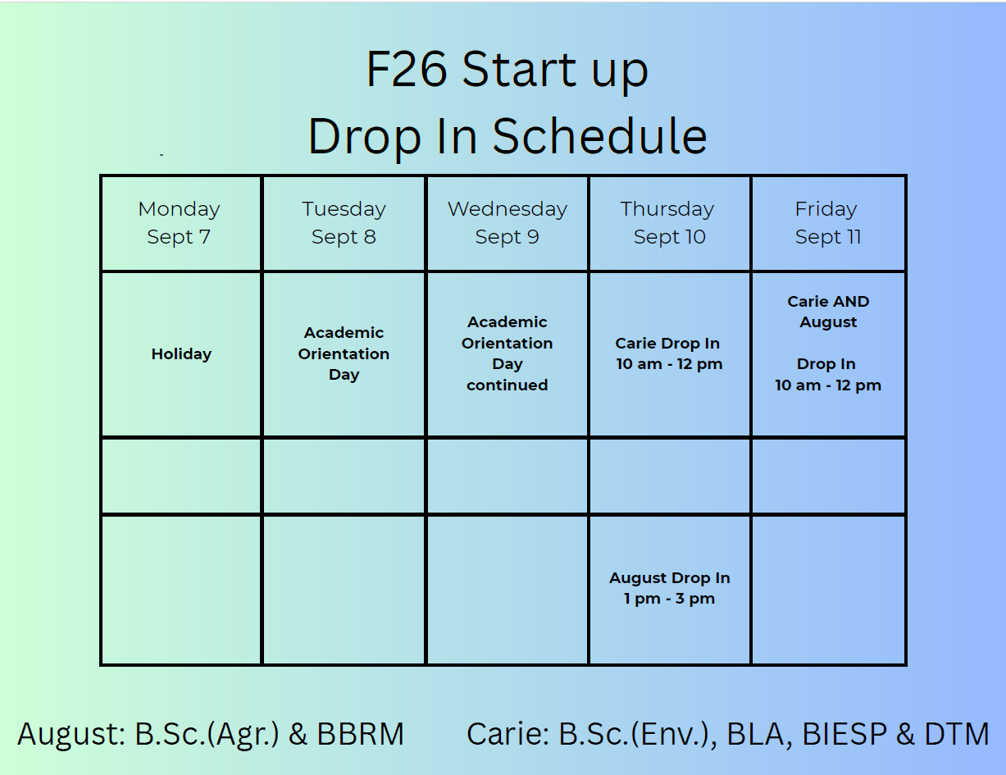

Slide 20
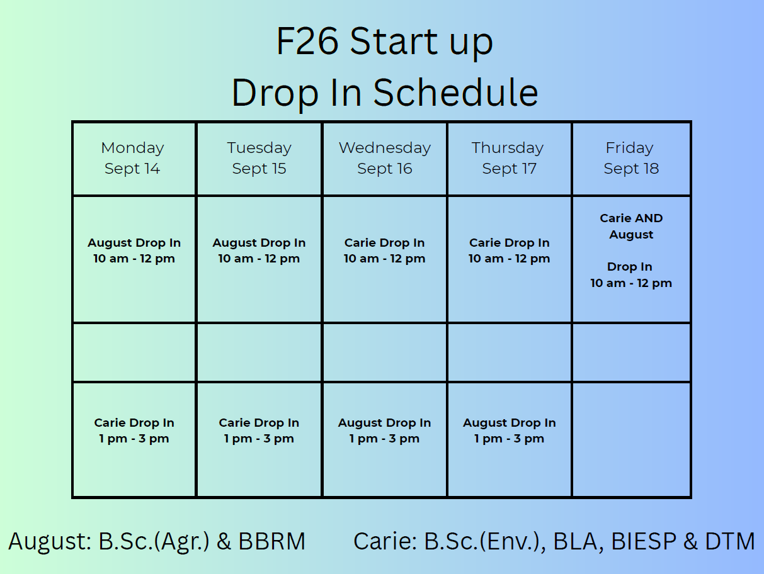

Slide 21
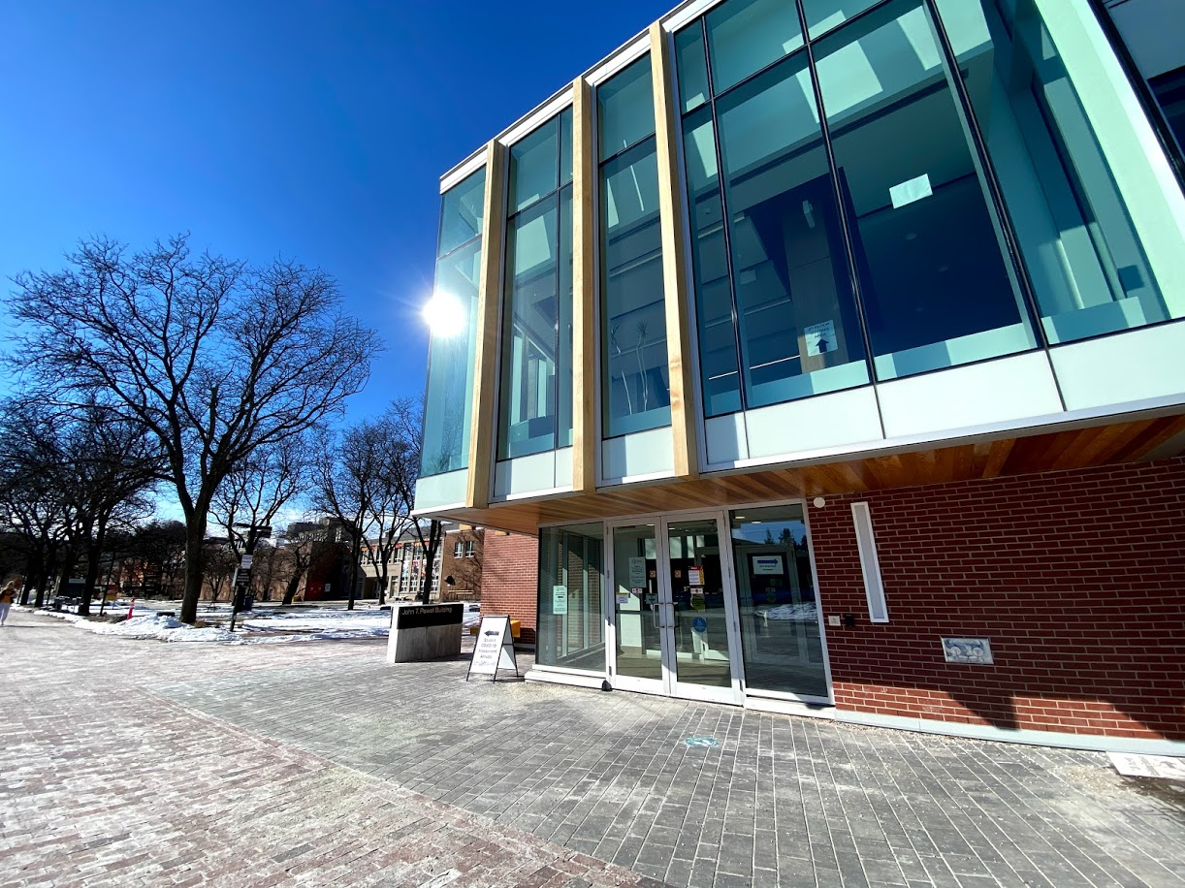
Student Accessibility Services (SAS)
Counselling Services
Student Health Services
Dedicated to providing health and well-being support and services to UofG students, all year long!
Health & Performance Centre (HPC)
Student Support Network (SSN)
Sexual & Gender-Based Violence Support & Education Centre
Wellness Education & Promotion Centre (WEPC)
wellness.uoguelph.ca

Slide 22
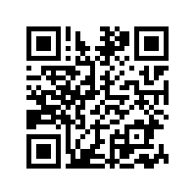
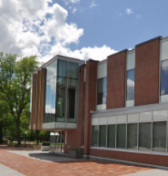
What if I’m in crisis?
Student Wellness offers Urgent Help…
Monday - Friday (8:30 am - 4:30 pm):
If a response is needed TODAY, contact 519-824-4120 ext. 52131
If a response can wait 24 hours, contact a Student Wellness Navigator by calling 519-824-4120 ext. 52131
Campus Safety Office (CSO): 519-824-4120 Ext. 2000 or 519-840-5000. An IMPACT mental health worker will respond with the campus safety office if available.
After Hours (after 4:30 pm or on weekends):
Campus Safety Office: For immediate on-campus responses, call 519-824-4120 Ext. 2000 or 519-840-5000
Local Police Services: For immediate off-campus responses, dial 911 for Emergency Services
Here 24/7 (Mental health resource): Call 1-844-HERE247 (1-844-437-3247) anytime.
Crisis Text Line: Text "UofG" to 686868

