Slide 1



Bachelor of Indigenous Environmental Science and Practice
Academic Orientation
Fall 2026
Your Host:
Carie Devitt
Academic Advisor

Slide 2
Goals of this Meeting
Meet YOUR BIESP Academic Advisor - Carie
Review important dates
General information and tips
Special Guests! Meet upper year BIESP students
Find out about resources available on campus like ISC and how to contact Carie ☺

Slide 3
Meet Carie ☺
Carie Devitt – Academic Advisor for all students in BIESP
(she/her)
First point of contact for BIESP program information
General policy help – making sense of the University Rules
Course schedule difficulties
Missed class time or exams (academic consideration)
Graduation Requirements
Never hesitate to ask for help!

Slide 4

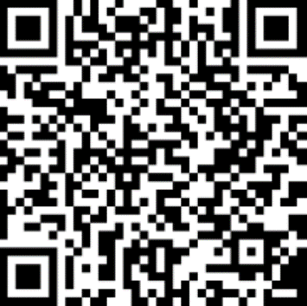
Important Dates
Last day to add classes or change course sections for F26 is September 18th
Last day to drop classes for F26 is the last class day –December 4th
Schedule of dates is in the current Undergraduate Calendar – stay on top of dates!
F26 Classes start Thursday September 10th Do NOT miss any classes!

Slide 5
BIESP
Program
Information
Bachelor of Indigenous Environmental Science and Practice is a degree program that does not have majors.
So, you will not have a major or attend the meetings for majors this week.
Four-year, honours degree; five-years if in the co-op program.
Can I minor? Yes. Important to plan for this early as completion of a minor will take more than 20 academic credits to complete.
In co-op? Register for COOP1100 in F27; Sequence of co-op work terms is Summer after 2nd year, and then a string of co-op terms after third year: summer, fall, then winter.
When planning for future semesters, you may choose courses along a theme that interests you. Examples of possible schedules of studies are on my website. I will send a link in a future course selection email!

Slide 6
Professors’ Expectations
Responsibilities
It’s up to you to seek out the information you need.
Help is available, but you NEED TO ASK
No one will chase down your assignments
If you hand something in late, you will lose marks. Not at all? You’ll get 0.
Deadlines
Ask instructors if you need mid-semester academic consideration for:
medical
psychological or
compassionate
grounds.
Learning expectations
Clearly laid out in
COURSE OUTLINES.
Carie’s TIP
Print them. Put dates on a calendar.
Go to class.
You can skip seminars and big labs and lectures and no one will notice!
Yikes!

Slide 7
General Survival Tips
Ask for help
I can’t emphasize this enough.
Download Outlook on your phone
Courselink - search ‘Courselink’ on the University of Guelph website www.uoguelph.ca
Instructors can help you IF you ask!
Become familiar with the academic policies!
Save Course Outlines
Check and use your @uoguelph.ca email
Check your program on WeAdvisor (coop vs non coop) and your timetable
Know what the Undergraduate Calendar is and how to find it.

Slide 8
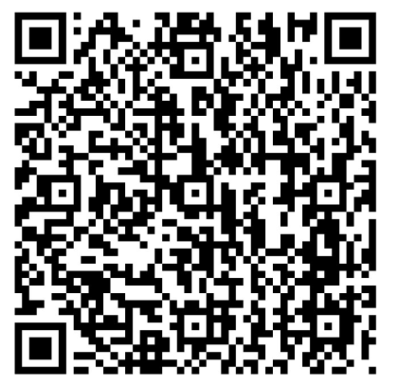
Get to know your degree requirements early on!
The WebAdvisor Student Planning System shows you personalized academic requirements for your degree. Summarized for you specifically, including what you have taken (including transfer credits if you have any!) and what you still need to take according your schedule of studies. This is also how you register for courses, so you’ve already seen it.
Your schedule of studies is found in the Undergraduate Calendar. It is the list of the courses you need to take to complete your degree. The schedule of studies is broken down by co-op or non-co-op and lists core courses and restricted electives you can choose from.
Program information for your degree is also in the Undergraduate Calendar (rules like needing a minimum of 6 credits at the 3000 level or higher and that of those, 2 credits must be at the 4000 level). Little details that mean a lot.
BIESP

Slide 9
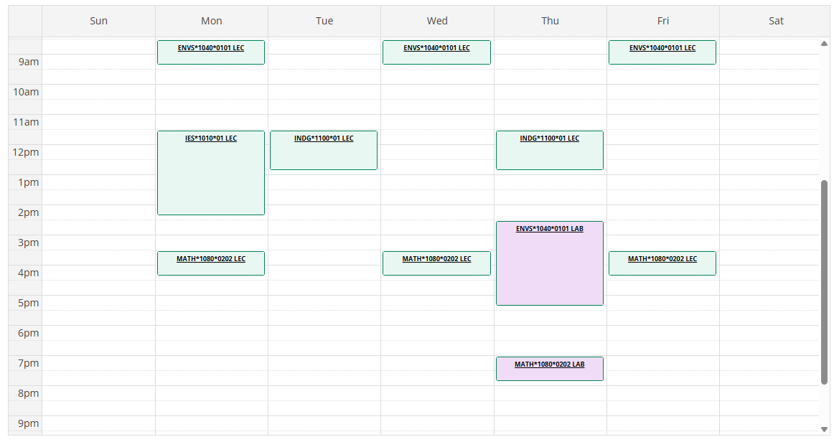
My Progress and Viewing your FALL Schedule on WebAdvisor

Slide 10
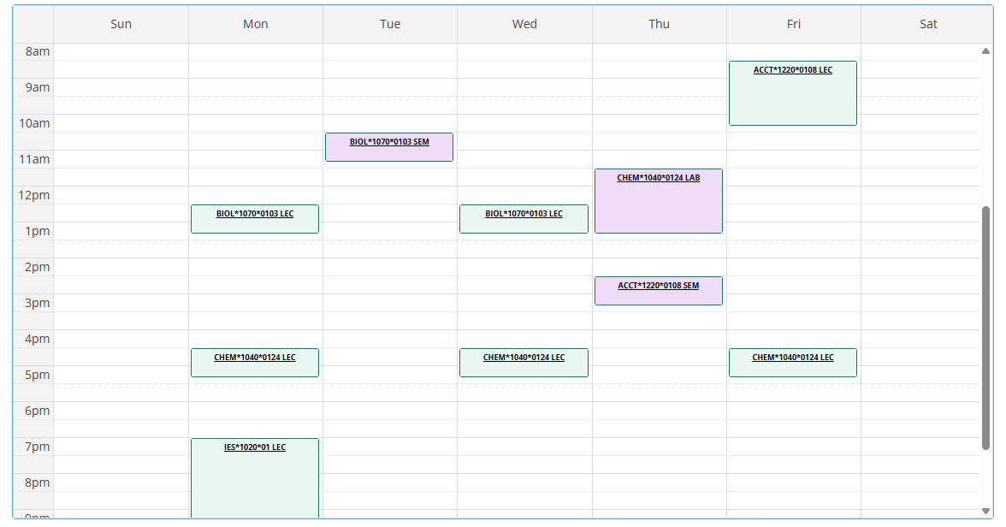
My Progress and Viewing your WINTER Schedule on WebAdvisor

Slide 11

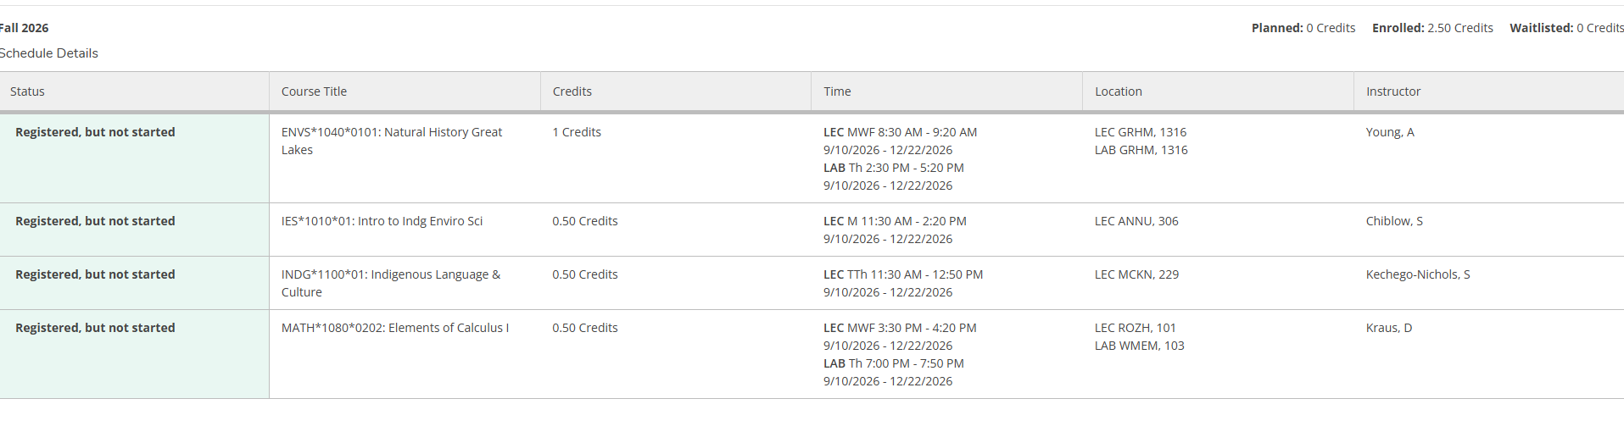
Schedule Print Button in WebAdvisor
This is the best way to double check / confirm that you are registered!

Slide 12
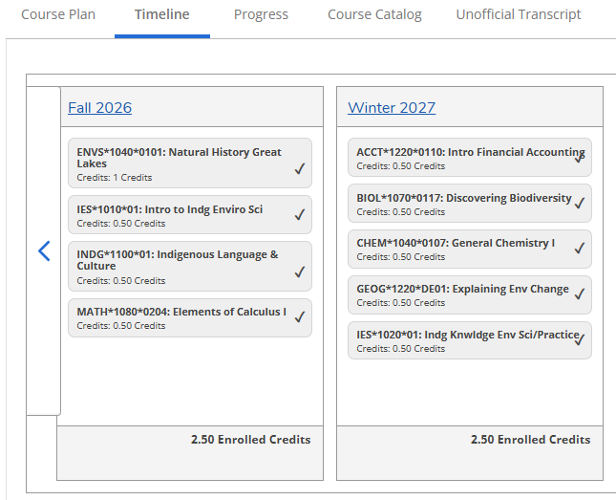
Timeline in WebAdvisor

Slide 13
What do all of the acronyms mean?
OAC is Ontario Agricultural College
  BIESP is an OAC program. Key for awards.
BIESP (or BIESP:C) is your degree program
  This is what will be after your name when you graduate
  If you see BIS or BIS:C, this is a short form used by university administration! (i.e. for Restrictions)
SAS is Student Accessibilities Services
  Offers services for students requiring accommodations
SLG is Supported Learning Groups
  Small group learning environments for select courses offered by the Library
TA is Teaching Assistant
  Work with instructors to help students with specific course

Slide 14
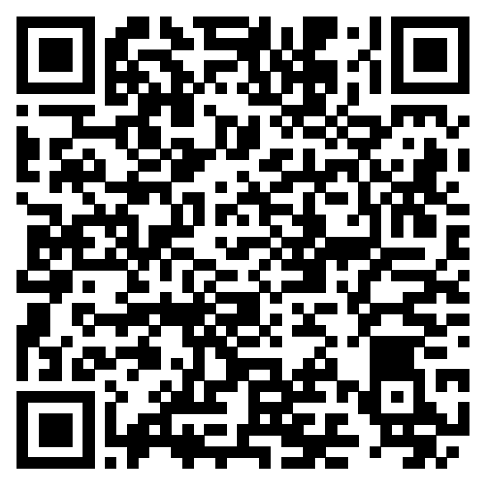
Upper Year Students ☺
Meet upper year students In biesp!
IES Student Council
Ies.sc@uoguelph.ca
Graham Hall Room:
3314
Instagram:
uofg_iessc
ENVIRONMENT STUDENT Mentorship program – register now!
Pro tips for first year courses…

Slide 15

How to find Carie…
Johnston Hall Room 133A
Email Carie at biesp@uoguelph.ca to book a virtual or in-person appointment!
Weekly DROP IN for F26
Wednesday 10 am – 12 pm

Slide 16
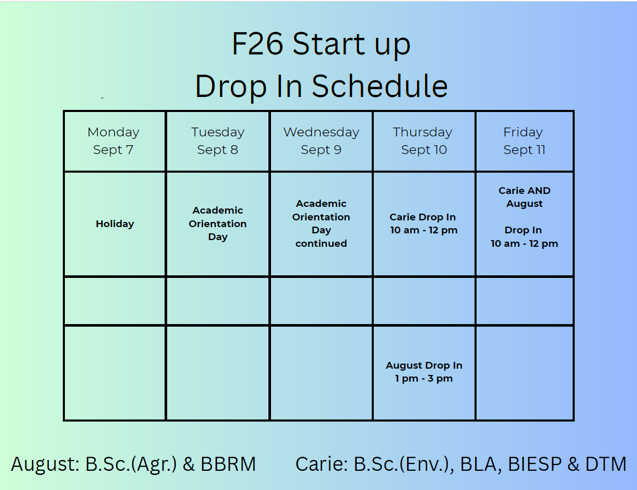

Slide 17
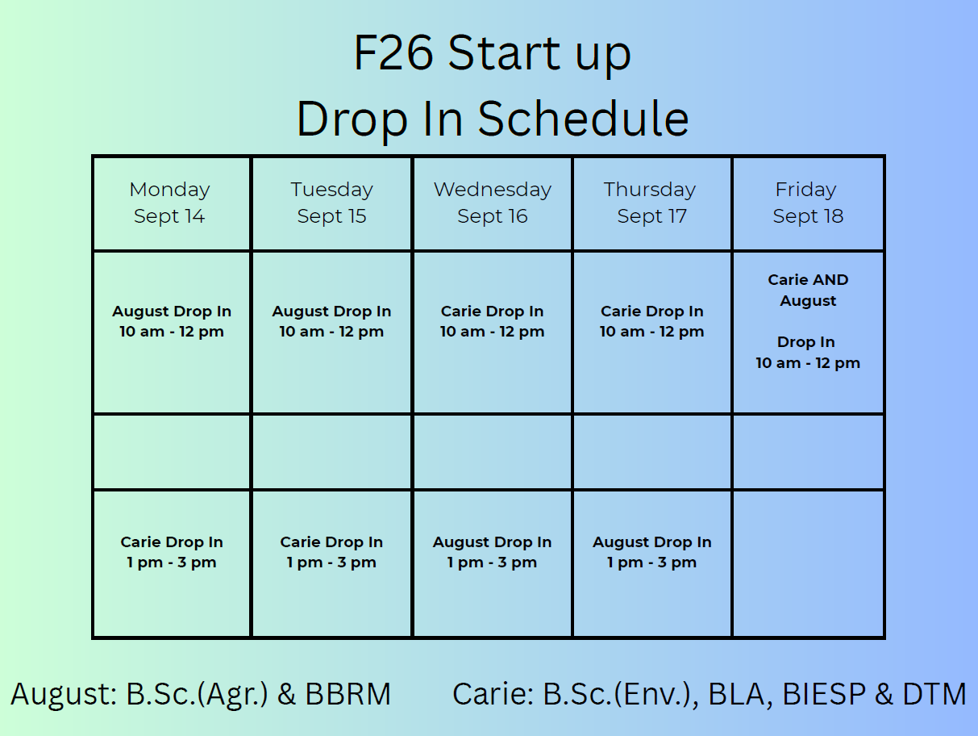

Slide 18
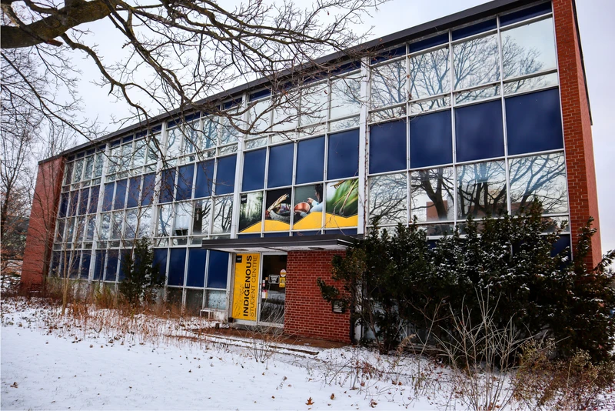
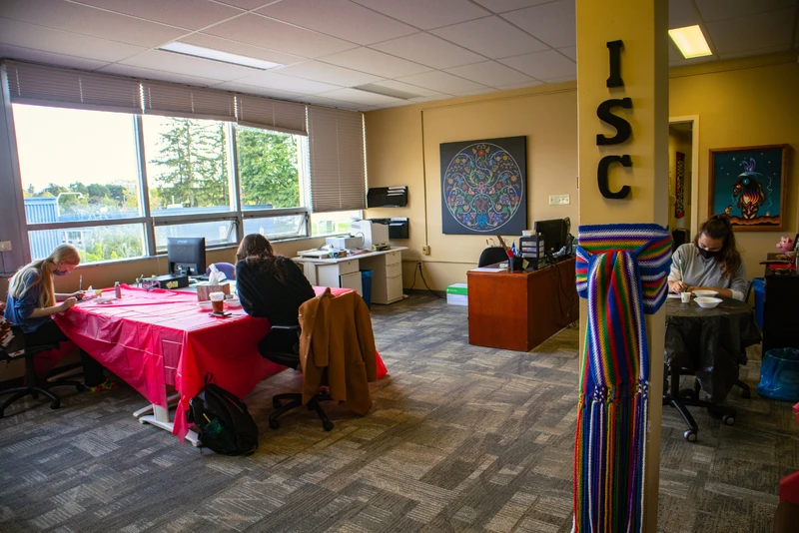
Helpful Resources
Indigenous Student Centre (ISC): Located in the Federal Building at 620 Gordon Street.
Indigenous Student Advisor is:
Laura Eaton leaton02@uoguelph.ca
The Indigenous Student Centre acts as a “home away from home” for First Nations, Métis and Inuit students.
Indigenous student counselling, study & lounge space, library, kitchen, free printing, workshops and programming.
A variety of First Nations, Métis and Inuit Elders and Knowledge Holders work with the ISC to provide workshops and cultural advising support.

Slide 19
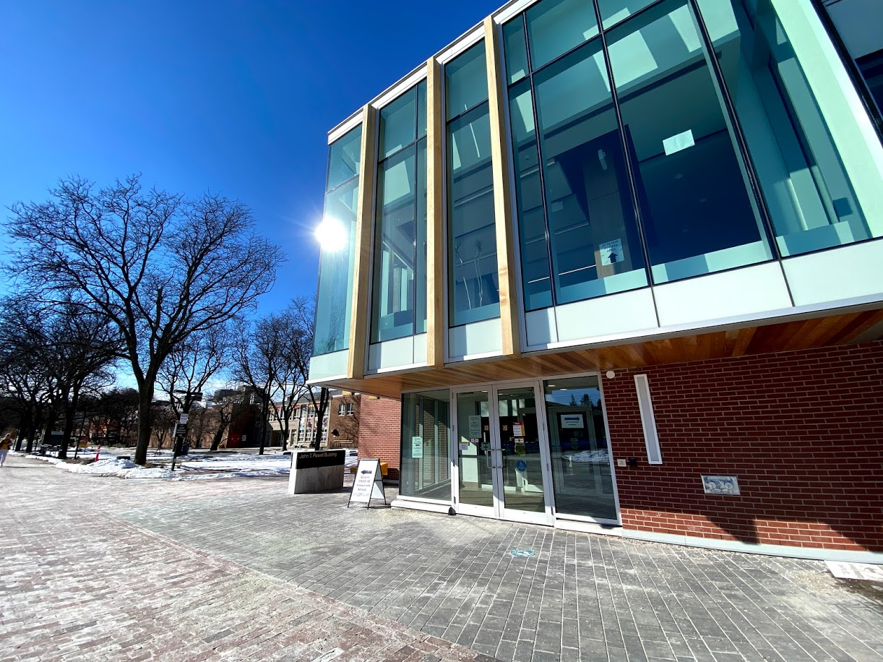
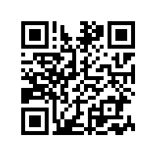
Student Accessibility Services (SAS)
Counselling Services
Student Health Services
Dedicated to providing health and well-being support and services to UofG students, all year long!
Health & Performance Centre (HPC)
Student Support Network (SSN)
Sexual & Gender-Based Violence Support & Education Centre
Wellness Education & Promotion Centre (WEPC)
wellness.uoguelph.ca

Slide 20
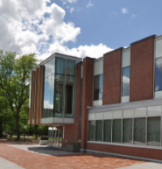
What if I’m in crisis?
Student Wellness offers Urgent Help…
Monday - Friday (8:30 am - 4:30 pm):
If a response is needed TODAY, contact 519-824-4120 ext. 52131
If a response can wait 24 hours, contact a Student Wellness Navigator by calling 519-824-4120 ext. 52131
Campus Safety Office (CSO): 519-824-4120 Ext. 2000 or 519-840-5000. An IMPACT mental health worker will respond with the campus safety office if available.
After Hours (after 4:30 pm or on weekends):
Campus Safety Office: For immediate on-campus responses, call 519-824-4120 Ext. 2000 or 519-840-5000
Local Police Services: For immediate off-campus responses, dial 911 for Emergency Services
Here 24/7 (Mental health resource): Call 1-844-HERE247 (1-844-437-3247) anytime.
Crisis Text Line: Text "UofG" to 686868

