Slide 1

Bachelor of Bio-Resource Management
Academic Information Session

Slide 2
Who Am I?
August Gaynor (they/them) – Academic Advisor
  First point of contact
  General policy help
  Course schedule difficulties
  Missed time (long term sickness)
  Missed final exams

Slide 3
Goals of this Presentation
Meet
Meet August.
Get
Get August’s contact information.
Find out
Find out more about the program and resources available.
Jot down
Jot down things to keep in mind; note that August sure does have some good information.
Absorb
Absorb at least 50% of what is talked about. 40% if the weather is nice.

Slide 4

What Did I Sign Up For?
Bachelor of Bio-Resource Management degree program
  Four year, honours degree, five years with co-op
  Two majors:
    Environmental Management (EM)
    Equine Management (EQM)
  Minor? Yes. But it’s tight!

Slide 5
Being Informed by People
Faculty Advisors
Today at 2:00 pm
Environmental Management with Dr. John Lauzon in MacKinnon room 233
Equine Management with Dr. Lee-Anne Huber in MacKinnon room 234
NOT your friends
They are great people, but sometimes are not correctly informed.

Slide 6
BBRM Student Council
Instagram : @uofg_bbrm
Plan events for all BBRM students
BBRM Lounge: GrAham Hall 3311/3312
Email them with questions and to be added to the listserv: BBRMSC@uoguelph.ca

Slide 7
SFOAC (Student Federation of the Ontario Agricultural College)
Will send listserv emails with information
Plan events for all OAC students
Website: aggies.ca

Slide 8
Being Informed
Undergraduate Calendar
Polices, degree requirements, dates, course information etc. https://www.uoguelph.ca/registrar/calendars/undergraduate
Listservs
Emails from me, SFOAC, BBRM Student Council and Registrar’s Office.
Websites
Search bar on uoguelph.ca
https://oac-program-counselling.uoguelph.ca/

Slide 9
All Set with your Schedule?
Make sure you have a working schedule.
Do not talk to students in other programs about number of classes! You take four in the Fall semester; five in Winter for Equine Management and four in Winter for Environmental Management.
Get to know WebAdvisor.

Slide 10
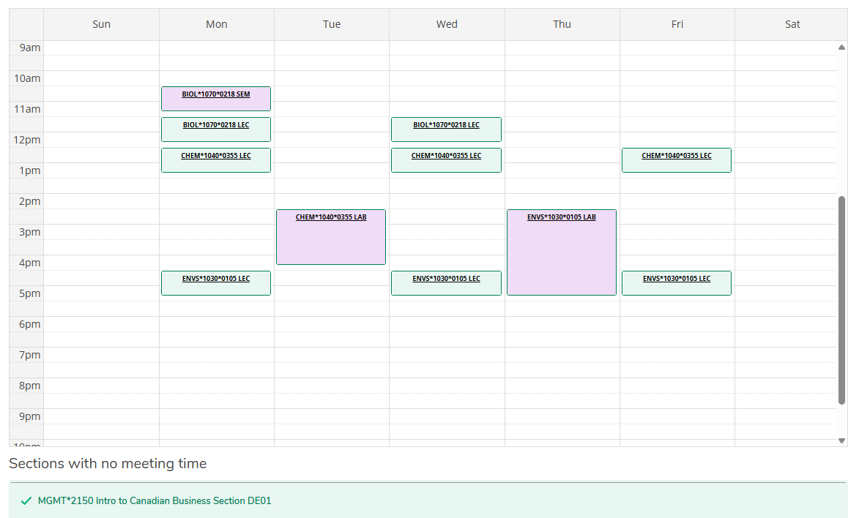
Viewing Schedule on WebAdvisor (EM example)

Slide 11

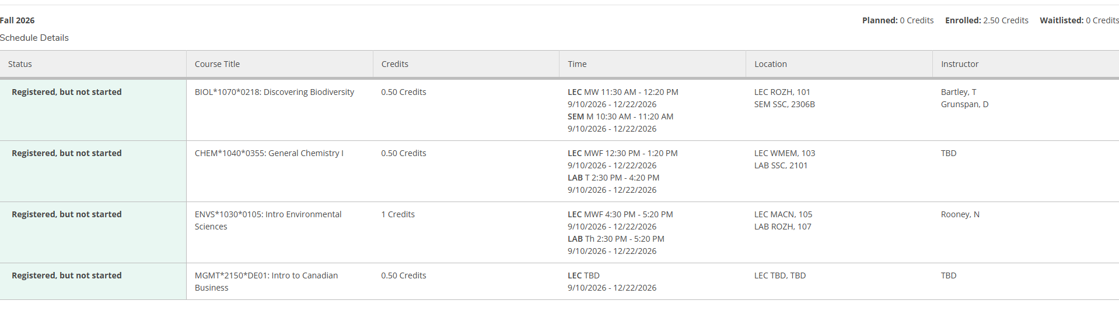
Schedule Print Feature

Slide 12
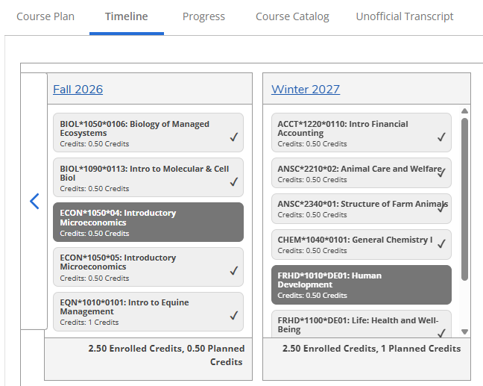

Timeline in WebAdvisor

Slide 13
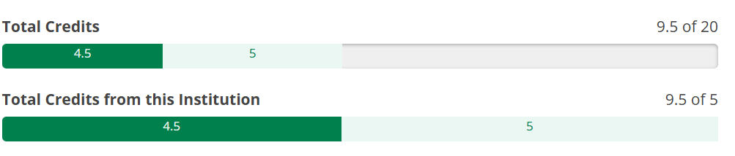
My Progress on WebAdvisor
Very helpful!
Offers a break down of your degree requirements and your progress towards completion

Slide 14
Course Survival Tips
Ask for help.
  I can’t emphasize this enough.
First day of classes – attend lectures/listen to first lecture
Course Outlines
  Read them! They contain important information concerning lab times, course policies, deadlines, etc.
Courselink for all class information
Instructors can help you!
If a class is not going well talk to someone (who?) before the last class day
Know the academic policies!
  For example, the continuation of studies and students' rights and responsibilities

Slide 15
Course Notes
Confirm you have no conflicts NOW!
Note how long some labs/lectures are
Why do some of my classes still say times are TBD?
Distance Education (DE) vs. Virtual
Do I need to “attend” synchronous courses?
Read outlines carefully to see what the requirements and resources are for each course
I don’t have a scheduled exam. Is that normal?
Alternates to exams

Slide 16
More Course Notes
Labs/Seminars
Might not be running this week; check course outline on Courselink
Finding classrooms:
https://classfind.com/guelph
https://www.uoguelph.ca/registrar/scheduling/buildingcodes-col (under Exam Locations)
Know the academic policies!
For example, the continuation of studies and student's rights and responsibilities; summer courses count!

Slide 17
How is University Different than High School?
Responsibilities
You are responsible for knowing policies/procedures.
No one will chase down your assignments
If you hand it in late, you will lose marks. Not at all? You’ll get 0.
Deadlines are deadlines
Things are due when they are due.
You can skip class and no one will notice
Sure, but then how will you do well?

Slide 18
How are they the same?
Involvement is good
Get involved, but learn time management.
Instructors are there to help
Be comfortable asking for assistance if needed.
Lots of great resources
Use the resources available!

Slide 19
Why is the University Structure so Confusing?
University is founded on colleges including OAC.
Programs/Majors are associated with colleges.
Some scholarships/bursaries are too.

Slide 20
What’s with all the Acronyms?
OAC is Ontario Agricultural College
  The college you are associated with
B.B.R.M. is your degree program
  This is what will be after your name when you graduate
LC is the Learning Commons
  In the library; offers writing, research, exam help
SAS is Student Accessibilities Services
  Offers services for students with disabilities
SLG is Supported Learning Groups
  Small group learning environments for select courses
TA is Teaching Assistant
  Work with instructors to help students with specific courses

Slide 21
Really? There are more?
FA is Faculty Advisor
  Faculty member who is an expert in your major
GLO is the Global Learning Opportunities office
  Department responsible for exchange
EL Hub is Experiential Learning Hub
  Runs job fairs, mock interviews, resume writing help
CSA is Central Student Association
  Your university student government

Slide 22
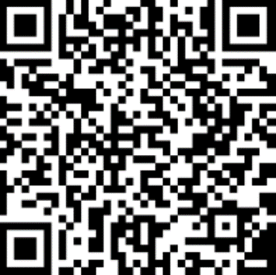
Important Dates
Last day to add classes:
September 18th
Last day to drop classes (Last Class Day):
December 4th
Schedule of Dates:

Slide 23
Take Away Tips
Network
Make connections with not only students, but faculty, staff and alumni.
Ask for Help
Course selection, job searching, if you are struggling etc.
Take Advantage of Resources
Chances are, we have a resource for you!
Explore Opportunities
Build your marketable skills through various opportunities to get involved.
Reflect
Take the time to think about what you are learning; what skills are you taking away for future employment?

Slide 24
Helpful Websites
OAC Academic Advising Website: https://oac-program-counselling.uoguelph.ca/
SFOAC Website: http://aggies.ca/
Counselling Services: https://wellness.uoguelph.ca/counselling/
Student Accessibility Services: https://wellness.uoguelph.ca/accessibility/
CSA www.csaonline.ca
Learning Commons: https://www.lib.uoguelph.ca/using-library/spaces/learning-commons
EL Hub: https://www.uoguelph.ca/experiential-learning/
The Cannon: www.thecannon.ca
Athletics: http://gryphons.ca/

Slide 25
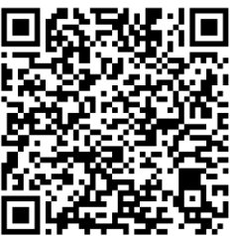
SES Undergraduate Mentoring Program
School of Environmental Sciences Undergraduate Mentoring Program
Pairs first-year students with an upper-year mentor
Mentors answer questions, connect their mentees with University resources and services, and offer social support to ease students' transition into university.
Interested? Deadline to apply is September 23rd, 2026.

Slide 26
That August Sure is Helpful…
Office Location: Johnston Hall room133A
  August’s email: oac.pco@uoguelph.ca
Weekly drop-in is available:
  Wednesdays, from 10am – 12pm
Booking appointments:
  Book by contacting August: oac.pco@uoguelph.ca
  Virtual and In-Person appointments available
My availability:
  Only during work hours (no weekends or nights)

Slide 27
Drop In Hours
For quick questions answered (in the order students arrive):
Thursday, September 10th – 1pm to 3pm
Friday, September 11th – 10am to 12pm
Monday, September 14th – 10am to 12pm
Tuesday, September 15th – 10am to 12pm
Wednesday, September 16th – 1pm to 3pm
Thursday, September 17th – 1pm to 3pm
Friday, September 18th – 10am to 12pm
In Johnston Hall, room 133A

Slide 28
What if I’m in crisis?
Crisis Text Line - Text UofG to 686868
Good2talk Helpline 1-866-925-5454 www.good2talk.ca
24-hour Indian Residential School Crisis Line - 1-866-925-4419
Victim Services Wellington – 519-824-1212 ext. 7304 or victim@vsw.on.ca
Guelph-Wellington Women in Crisis (24/7 crisis line) –
519-836-5710 or adminrec@gwwomenincrisis.org
HERE 24/7 – 1-844-437-3247
Suicide Crisis Helpline – Text or call 988

