Slide 1
Bachelor of Landscape Architecture
Academic Information Session

Slide 2
Who Am I?
Melinda Vanryn - Program Counsellor
First point of contact
General policy help
Course schedule difficulties
Missed time (long term sickness)
Missed final exams

Slide 3
Being Informed
Undergraduate Calendar
Polices, degree requirements, dates, course information etc.
Listservs
Emails from me, SFOAC, Diana and Registrar’s Office.
Websites
Search bar on uogueph.ca
https://oac-program-counselling.uoguelph.ca/

Slide 4
Being Informed by People
Martin Holland
Specialist for your degree program
Diana Foolen
Jack of all trades; will get you the information you need or point you in the right direction
NOT your friends
They are great people, but sometimes are not correctly informed.

Slide 5
Program/Academic Evaluation
Best. Help. Ever.

Slide 6
Course Notes
Confirm you have no conflicts NOW!
Note how long some labs/lectures are
Why do some of my classes still say times are TBD?
Distance Education (DE) vs. Asynchronous
Do I need to “attend” synchronous courses?
Read outlines carefully to see what the requirements and resources are for each course
I don’t have a scheduled exam. Is that normal?
Alternates to exams
https://www.uoguelph.ca/registrar/f20courses

Slide 7
What’s with all the Acronyms?
OAC is Ontario Agricultural College
The college you are associated with
BLA is your degree program
This is what will be after your name when you graduate
SEDRD is the School of Environmental Design and Rural Development
The department you are associated with
LC is the Learning Commons
In the library; offers writing, research, exam help
SAS is Student Accessibilities Services
Offers services for students with disabilities
SLG is Supported Learning Groups
Small group learning environments for select courses
TA is Teaching Assistant
Work with instructors to help students with specific courses

Slide 8
Really? There are more?
FA is Faculty Advisor
Faculty member who is an expert in your major; you have no major, but Martin is your expert for BLA.
CIP is Centre for International Programs
Department responsible for exchange
CECS is Coop and Career Services
Runs job fairs, mock interviews, resume writing help
LASS is Landscape Architecture Student Society
Your degree program student government
SFOAC is Student Federation of the Ontario Agricultural College
Your college student government
CSA is Central Student Association
Your university student government

Slide 9
Important Dates
Last day to add classes:
September 18th
Last day to drop classes (Last Class Day):
December 4th
All dates:
https://www.uoguelph.ca/registrar/calendars/undergraduate/current/c03/index.shtml

Slide 10
Take Away Tips
Network
Make connections with not only students, but faculty, staff and alumni.
Ask for help
Course selection, job searching, if you are struggling etc.
Take Advantage of Resources
Chances are, we have a resource for you!
Explore Opportunities
Build your marketable skills through various opportunities to get involved.
Reflect
Take the time to think about what you are learning; what skills are you taking away for future employment?

Slide 11
Helpful Websites
Program Counsellor Website: www.uoguelph.ca/bla
SFOAC Website: http://aggies.ca/
SEDRD: https://www.uoguelph.ca/sedrd/
Counselling Services: https://wellness.uoguelph.ca/counselling/
Student Accessibility Services: https://wellness.uoguelph.ca/accessibility/
CSA: www.csaonline.ca
Learning Commons: https://learningcommons.lib.uoguelph.ca/
Career Services: https://www.recruitguelph.ca/cecs/
The Cannon: www.thecannon.ca
Athletics: http://gryphons.ca/
Experiential Learning Opportunities: https://experienceguelph.ca/home.htm

Slide 12
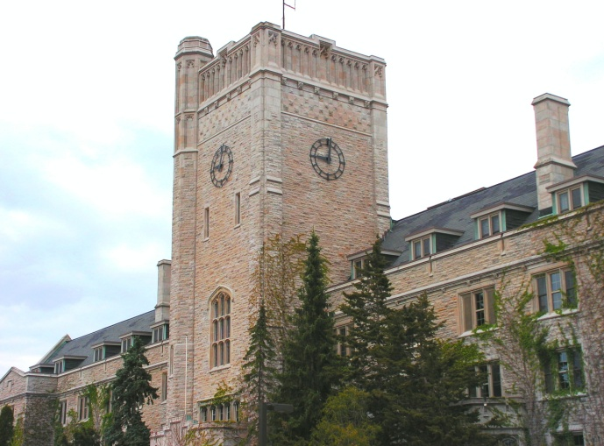
That Melinda Sure is Helpful…
Office Location: Her Basement ☹
Our physical office is closed and we are working remotely
Availability:
Typically 8am – 4pm Monday to Friday
Virtual Drop In Hours run on Teams this week and next week
After Sept 18th, I will note how to contact me (virtual drop in hours are a trial offering!)
Email: mavanryn@uoguelph.ca

