Slide 1

Bachelor of Landscape Architecture
Academic Information Session

Slide 2
Who Am I?
Carie Devitt
BLA Academic Advisor
  First point of contact
  General policy help
  Course schedule difficulties
  Planning for minors and Certificates
  Exchange
  Missed final exams

Slide 3

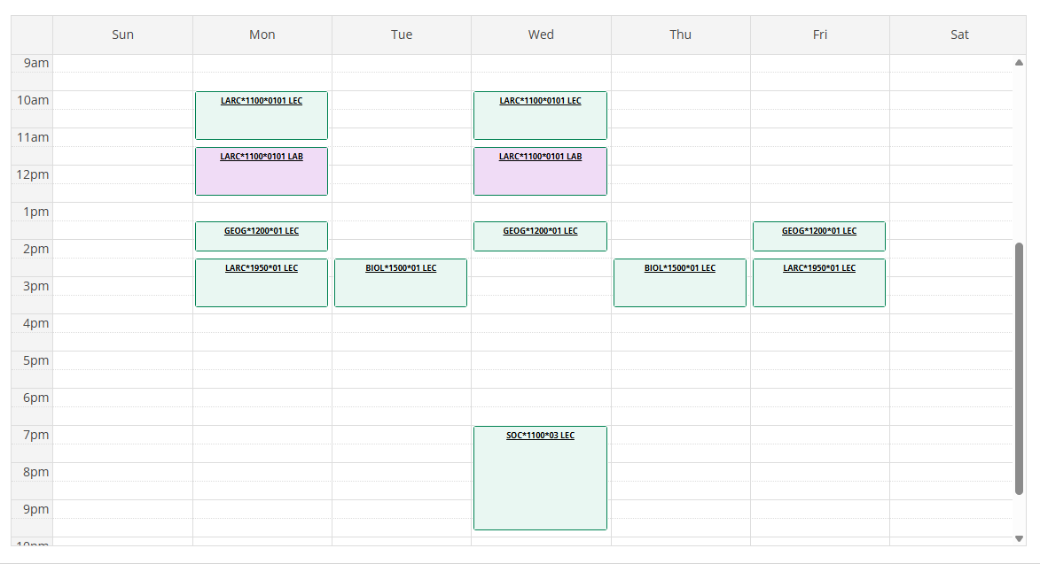
Viewing your Schedule on WebAdvisor

Slide 4

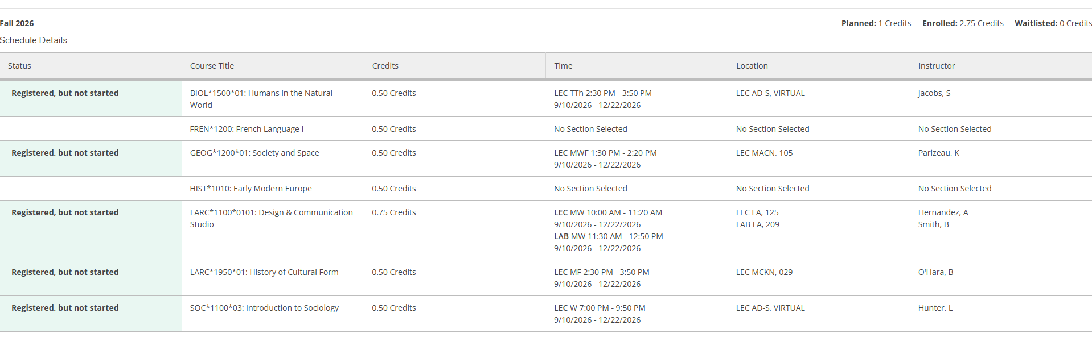
Schedule Print Feature

Slide 5
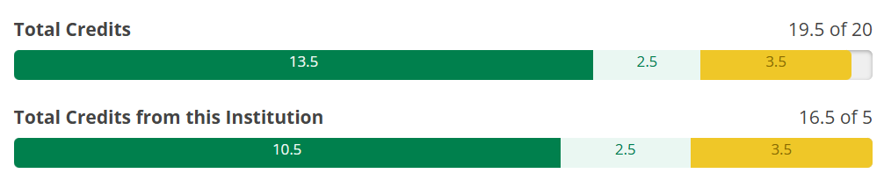
My Progress and Planning Tool on WebAdvisor
Very helpful for degree requirements!
Allows you to plan your courses for all four years

Slide 6
Check list!
Did you register for Fall and Winter courses?
  Confirm registered, not just planned?!
Are you in 2.75 credits in each semester?
  Fall semester will have FIVE courses for a total of 2.75 credits
  Winter semester will have FIVE courses for a total of 2.75 credits
Do you have any timetable conflicts?

Slide 7
Course Survival Tips
Ask for help.
I can’t emphasize this enough.
Go to class! Why do some of my classes still say times are TBD? DE01 means it’s an online course
Course Outlines
Read them! They contain important information concerning lab times, course policies etc.
Courselink for all class information
Instructors can help you!
If a class is not going well talk to someone (who?) before the last class day

Slide 8
Course Notes
Labs/Seminars
Might not be running this week; check course outline/Courselink
Finding classrooms:
https://classfind.com/guelph
Know there are academic policies!
For example, continuation of studies, academic consideration, deferred exams, and student's rights and responsibilities…

Slide 9
Important Dates
Last day to add classes for F26:
September 18th
Last day to drop classes F26 (Last Class Day):
December 4th
All dates:

Slide 10
What’s with all the Acronyms?
OAC is Ontario Agricultural College
  The college you are associated with
BLA is your degree program
  This is what will be after your name when you graduate
SEDRD is the School of Environmental Design and Rural Development
  The department you are associated with
LC is the Learning Commons
  In the library; offers writing, research, exam help
SAS is Student Accessibilities Services
  Offers services for students with disabilities
SLG is Supported Learning Groups
  Small group learning environments for select courses

Slide 11
Really? There are more?
TA is Teaching Assistant
  Work with instructors to help students with specific courses
FA is Faculty Advisor
  Faculty member who is an expert in your major; you have no major, but Brendan is your expert for BLA
GLO is Global Learning Opportunities office
  Department responsible for exchange
EL Hub is Experiential Learning Hub
  Runs job fairs, mock interviews, resume writing help
LASS is Landscape Architecture Student Society
  Your degree program student government
SFOAC is Student Federation of the Ontario Agricultural College
  Your college student government
CSA is Central Student Association
  Your university student government

Slide 12
Take Away Tips
Network
Make connections with other students, faculty, staff, and BLA alumni.
Ask for Help
Course selection, job searching, if you are struggling etc.
Explore Opportunities
Build your marketable skills through various opportunities to get involved.

Slide 13
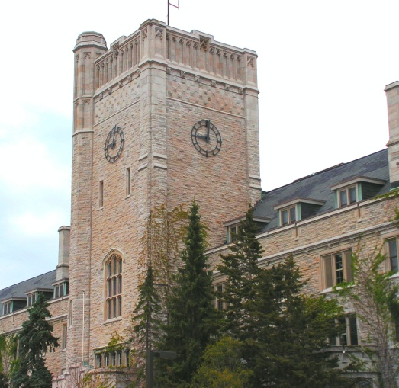
How to find Carie…
Johnston Hall Room 133A
Email Carie at cdevitt@uoguelph.ca to book a virtual or in-person appointment!
F26 Weekly DROP IN
Wednesdays 10 am-12 pm
Please Read my emails ☺

Slide 14
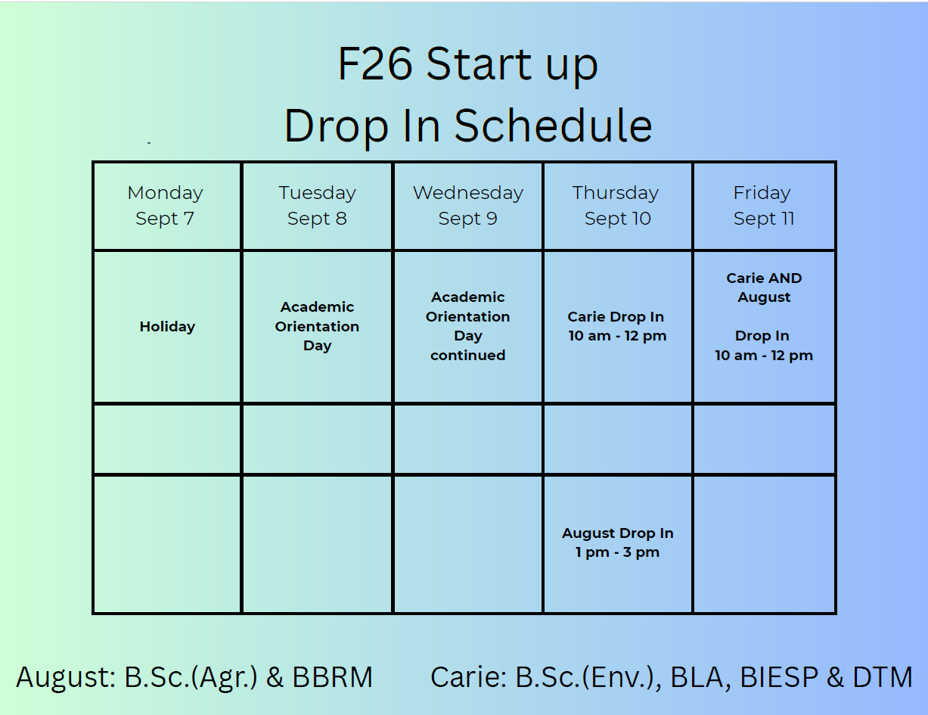

Slide 15
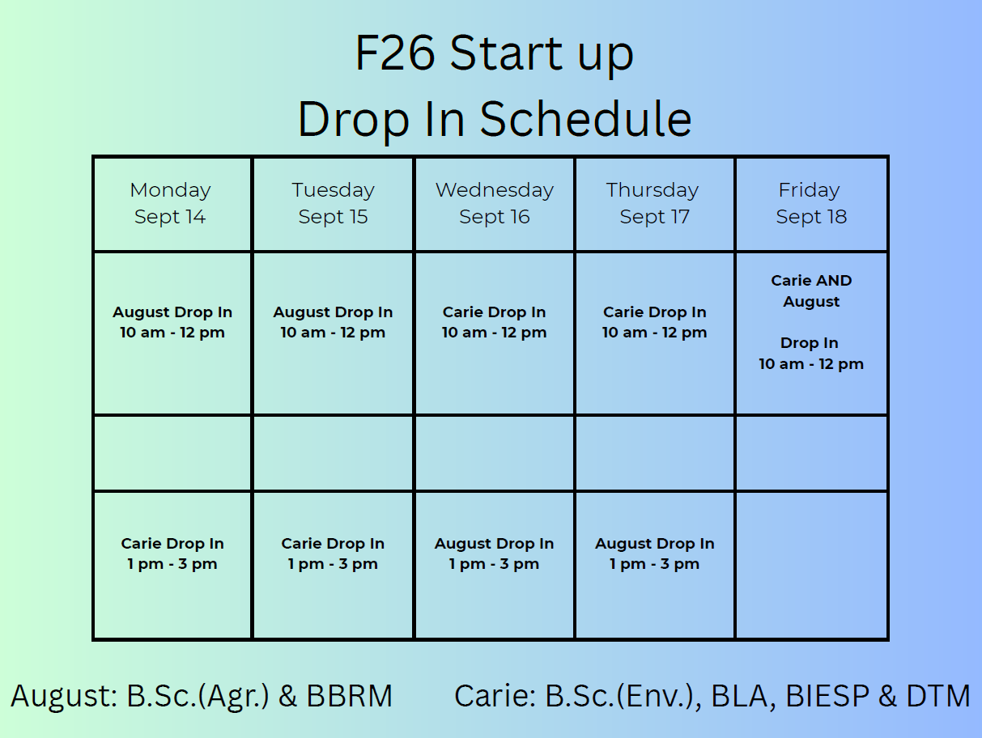

Slide 16
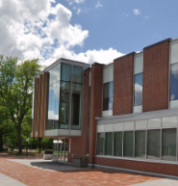
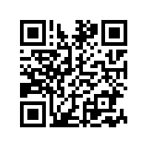
What if I’m in crisis?
Student Wellness offers Urgent Help…
Monday - Friday (8:30 am - 4:30 pm):
If a response is needed TODAY, contact 519-824-4120 ext. 52131
If a response can wait 24 hours, contact a Student Wellness Navigator by calling 519-824-4120 ext. 52131
Campus Safety Office (CSO): 519-824-4120 Ext. 2000 or 519-840-5000. An IMPACT mental health worker will respond with the campus safety office if available.
After Hours (after 4:30 pm or on weekends):
Campus Safety Office: For immediate on-campus responses, call 519-824-4120 Ext. 2000 or 519-840-5000
Local Police Services: For immediate off-campus responses, dial 911 for Emergency Services
Here 24/7 (Mental health resource): Call 1-844-HERE247 (1-844-437-3247) anytime.
Crisis Text Line: Text "UofG" to 686868

