Slide 1
Bachelor of Science in Agriculture
Virtual Academic Information Session

Slide 2
Who Am I?
Melinda Vanryn - Program Counsellor
First point of contact
General policy help
Course schedule difficulties
Missed time (long term sickness)
Missed final exams

Slide 3
Strange Times…
“Unpredicted”
Def’n: time to innovate, be optimistic, be flexible and redefine what is normal.
Never hesitate to ask for help – especially now
Communication and a willingness to stay connected will be key.
Not everything is different
Still a friendly campus of staff and faculty here to help you

Slide 4
Goals of this Meeting
Meet Melinda.
Get Melinda’s contact information.
Find out more about the program and resources available.
Jot down things to keep in mind; note that Melinda sure does have some good information.
Absorb at least 50% of what is talked about. 40% if the weather is nice.

Slide 5
What Did I Sign Up For?
Bachelor of Science in Agriculture degree program
Four year, honours degree
Undeclared (for now!)
*New* FOUR majors to choose from:
Honours Agriculture
Horticulture *
Crop Science *
Animal Science
Minor? Yes.

Slide 6
How is University Different than High School?
Responsibilities
You are responsible for knowing policies/procedures.
No one will chase down your assignments
If you hand it in late, you will lose marks. Not at all? You’ll get 0.
Deadlines are deadlines
Things are due when they are due.
Learning expectations
Less memory work, more connections/problem solving.
You can skip class and no one will notice
Sure, but then how will you do well?

Slide 7
How are they the same?
Involvement is good
Get involved, but learn time management.
Instructors are there to help
Be comfortable asking for assistance if needed.
Lots of great resources
Use the resources available!

Slide 8
Being Informed
Undergraduate Calendar
Polices, degree requirements, dates, course information etc.
Listservs
Emails from me, SFOAC and Registrar’s Office.
Websites
Search bar on uogueph.ca
https://oac-program-counselling.uoguelph.ca/

Slide 9
Being Informed by People
Faculty Advisors:
Animal Science – Dr. Ira Mandell
Horticulture and Crop Science – TBD
Honours Agriculture – Dr. Vern Osborne
Meeting for Majors session now just because of timing
We will set up a meeting in Winter semester to dig into majors a bit more
NOT your friends
They are great people, but sometimes are not correctly informed.

Slide 10
SFOAC (Student Federation of the Ontario Agricultural College)
Will send listserv emails with information
Plan events for all OAC students
Website: aggies.ca

Slide 11
My Progress and Planning Tools on WebAdvisor
Very helpful!
A few quirks (e.g. never look at the Progress bar; it’s always incorrect!).

Slide 12
Why is the University Structure so Confusing?
University is founded on colleges including OAC.
Programs/Majors are associated with colleges.
Some scholarships/bursaries are too.

Slide 13
What’s with all the Acronyms?
OAC is Ontario Agricultural College
The college you are associated with
B.Sc.(Agr.) is your degree program (or BSAG)
This is what will be after your name when you graduate
LC is the Learning Commons
In the library; offers writing, research, exam help
SAS is Student Accessibilities Services
Offers services for students with disabilities
SLG is Supported Learning Groups
Small group learning environments for select courses
TA is Teaching Assistant
Work with instructors to help students with specific courses

Slide 14
Really? There are more?
FA is Faculty Advisor
Faculty member who is an expert in your major
CIP is Centre for International Programs
Department responsible for exchange
CECS is Coop and Career Services
Runs job fairs, mock interviews, resume writing help
SFOAC is Student Federation of the Ontario Agricultural College
Your college student government
CSA is Central Student Association
Your university student government

Slide 15
Course Survival Tips
Ask for help.
I can’t emphasize this enough.
First day of classes - attend lectures/listen to first lecture
Course Outlines
Read them! They contain important information concerning lab times, course policies etc.
Courselink
Instructors can help you!
If a class is not going well talk to someone (who?) before the last class day
Know the academic policies!
For example, the continuation of studies and students rights and responsibilities; summer courses count!

Slide 16
Course Notes
Confirm you have no conflicts NOW!
Note how long some labs/lectures are
Why do some of my classes still say times are TBD?
Distance Education (DE) vs. Asynchronous vs. Remote
Do I need to “attend” synchronous courses?
Read outlines carefully to see what the requirements and resources are for each course
I don’t have a scheduled exam. Is that normal?
Alternates to exams

Slide 17
Important Dates
Last day to add classes:
September 17th
Last day to drop classes (Last Class Day):
December 3rd
All dates:
https://www.uoguelph.ca/registrar/calendars/undergraduate/current/c03/index.shtml

Slide 18
Take Away Tips
Network
Make connections with not only students, but faculty, staff and alumni.
Ask for help
Course selection, job searching, if you are struggling etc.
Take Advantage of Resources
Chances are, we have a resource for you!
Explore Opportunities
Build your marketable skills through various opportunities to get involved.
Reflect
Take the time to think about what you are learning; what skills are you taking away for future employment?

Slide 19
Helpful Websites
Program Counsellor Website: https://oac-program-counselling.uoguelph.ca/
SFOAC Website: http://aggies.ca/
Counselling Services: https://wellness.uoguelph.ca/counselling/
Student Accessibility Services: https://wellness.uoguelph.ca/accessibility/
CSA www.csaonline.ca
Learning Commons: https://learningcommons.lib.uoguelph.ca/
Career Services: https://www.recruitguelph.ca/cecs/
The Cannon: www.thecannon.ca
Athletics: http://gryphons.ca/
Experiential Learning Opportunities: https://experienceguelph.ca/home.htm

Slide 20
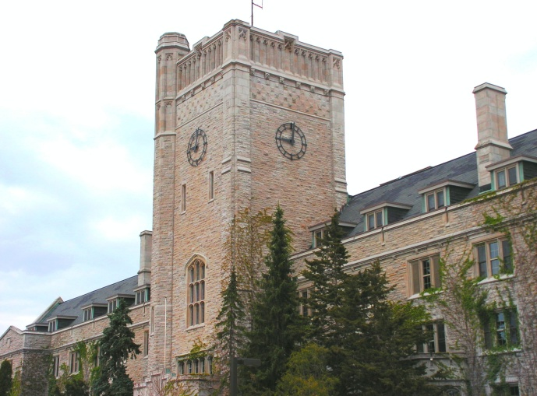
That Melinda Sure is Helpful…
Office Location: Her Basement ☹
Our physical office is closed and we are working remotely
Melinda’s email: mavanryn@uoguelph.ca
Availability:
Typically 8am – 4pm Monday to Friday
Booking appointments:
Done through my assistant, Ellen: https://oac-program-counselling.uoguelph.ca/contact/bscagr-contacts
Note I am on medical leave effective today for approximately 3 weeks.

