Slide 1


Bachelor of Science in Agriculture
Academic Information Session

Slide 2

Who Am I?
August Gaynor (they/them) – Academic Advisor
  First point of contact
  General policy help
  Course schedule difficulties
  Missed time (long term sickness)
  Missed final exams

Slide 3
Goals of this Meeting
Meet August.
Get August’s contact information.
Find out more about the program and resources available.
Jot down things to keep in mind; note August sure does have some good information.
Absorb at least 50% of what is talked about. 40% if the weather is nice.

Slide 4

What Did I Sign Up For?
Bachelor of Science in Agriculture degree program
  Four year, honours degree, five with co-op
  Undeclared (for now!)
  FOUR majors to choose from:
    Honours Agriculture
    Horticulture
    Crop Science
    Animal Science
  Minor? Yes.

Slide 5
Being Informed
Undergraduate Calendar
Polices, degree requirements, dates, course information etc. https://www.uoguelph.ca/registrar/calendars/undergraduate
Listservs
Emails from me, SFOAC and Registrar’s Office.
Websites
Search bar on uoguelph.ca
https://oac-program-counselling.uoguelph.ca/

Slide 6
Being Informed by People
Faculty Advisors:
  Animal Science – Dr. Andy Robinson
  Horticulture – Dr. Barry Micallef
  Crop Science – Dr. François Tardif
  Honours Agriculture – Dr. Lee-Anne Huber
No Meeting for Majors!
  We will set up a meeting in Winter semester to dig into majors a bit more
NOT your friends
  They are great people, but sometimes are not correctly informed.

Slide 7
SFOAC (Student Federation of the Ontario Agricultural College)
Will send listserv emails with information
Plan events for all OAC students
Website: aggies.ca

Slide 8
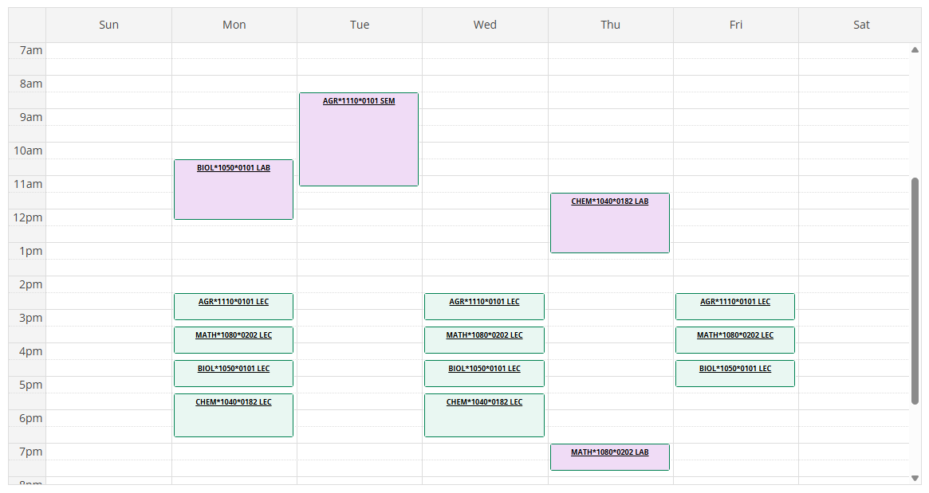
Viewing your Schedule

Slide 9

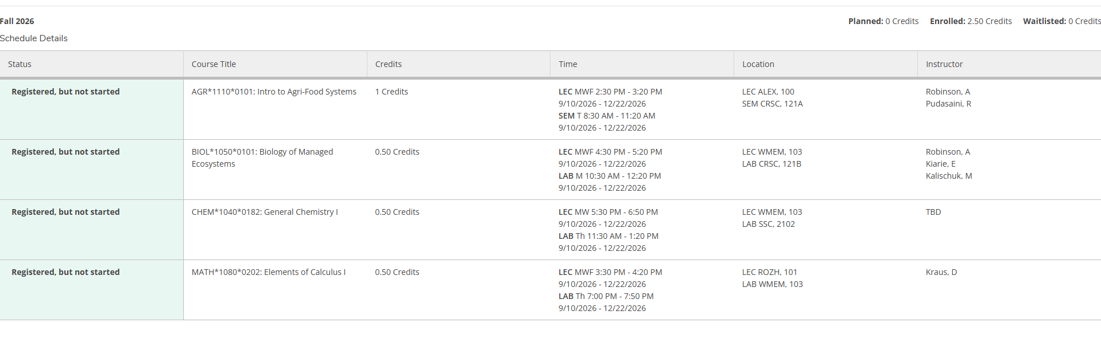
Schedule Print Feature

Slide 10
Course Notes
Confirm you have no conflicts NOW!
Note how long some labs/lectures are
Exam conflicts
Why do some of my classes still say times are TBD?
Distance Education (DE) vs. Virtual
I don’t have a scheduled exam. Is that normal?
Alternates to exams
Textbooks
Required ones in course outline

Slide 11
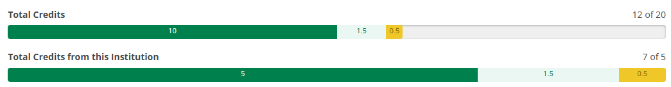
My Progress and Planning Tools on WebAdvisor
Very helpful!
Look at total credits and (once declared), lists of requirements

Slide 12

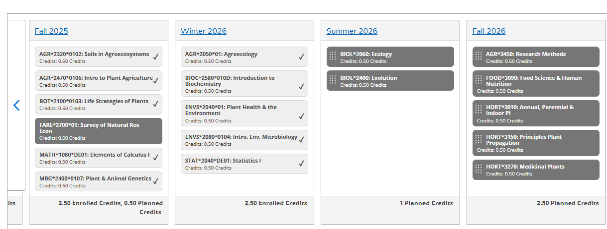
Timeline in WebAdvisor

Slide 13
How is University Different than High School?
Responsibilities
You are responsible for knowing policies/procedures.
No one will chase down your assignments
If you hand it in late, you will lose marks. Not at all? You’ll get 0.
Deadlines are deadlines
Things are due when they are due.
You can skip class and no one will notice
Sure, but then how will you do well?

Slide 14
How are they the same?
Involvement is good
Get involved, but learn time management.
Instructors are there to help
Be comfortable asking for assistance if needed.
Lots of great resources
Use the resources available!

Slide 15
Why is the University Structure so Confusing?
University is founded on colleges including OAC.
Programs/Majors are associated with colleges.
Some scholarships/bursaries are too.

Slide 16
What’s with all the Acronyms?
OAC is Ontario Agricultural College
  The college you are associated with
B.Sc.(Agr.) is your degree program (or BSAG)
  This is what will be after your name when you graduate
LC is the Learning Commons
  In the library; offers writing, research, exam help
SAS is Student Accessibilities Services
  Offers services for students with disabilities
SLG is Supported Learning Groups
  Small group learning environments for select courses

Slide 17
Really? There are more?
TA is Teaching Assistant
  Work with instructors to help students with specific courses
FA is Faculty Advisor
  Faculty member who is an expert in your major
GLO is the Global Learning Opportunities office
  Department responsible for exchange
EL Hub is Experiential Learning Hub
  Runs job fairs, mock interviews, resume writing help
SFOAC is Student Federation of the Ontario Agricultural College
  Your college student government
CSA is Central Student Association
  Your university student government

Slide 18
Course Survival Tips
Ask for help.
I can’t emphasize this enough.
First day of classes - attend lectures/listen to first lecture
Course Outlines
Read them! They contain important information concerning lab times, course policies etc.
Courselink for all class information
Instructors can help you!
If a class is not going well talk to someone (who?) before the last class day

Slide 19
More Course Notes
Labs/Seminars
Might not be running this week; check course outline/Courselink
Finding classrooms:
https://classfind.com/guelph
https://www.uoguelph.ca/registrar/scheduling/buildingcodes-col
Know the academic policies!
For example, the continuation of studies and student's rights and responsibilities; summer courses count!

Slide 20
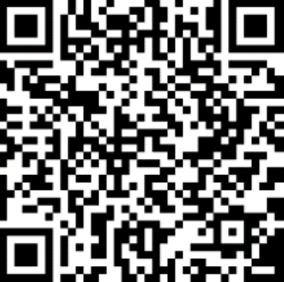
Important Dates
Last day to add classes:
September 18th
Last day to drop classes (Last Class Day):
December 4th
Schedule of Dates:

Slide 21
Take Away Tips
Network
Make connections with not only students, but faculty, staff and alumni.
Ask for help
Course selection, job searching, if you are struggling etc.
Take Advantage of Resources
Chances are, we have a resource for you!
Explore Opportunities
Build your marketable skills through various opportunities to get involved.
Reflect
Take the time to think about what you are learning; what skills are you taking away for future employment?

Slide 22
Helpful Websites
Academic Advising Website: https://oac-program-counselling.uoguelph.ca/
SFOAC Website: http://aggies.ca/
Counselling Services: https://wellness.uoguelph.ca/counselling/
Student Accessibility Services: https://wellness.uoguelph.ca/accessibility/
CSA www.csaonline.ca
Learning Commons: https://www.lib.uoguelph.ca/using-library/spaces/learning-commons
EL Hub: https://www.recruitguelph.ca/cecs/
The Cannon: www.thecannon.ca
Athletics: http://gryphons.ca/

Slide 23
That August Sure is Helpful…
Office Location: Johnston Hall room133A
  August’s email: oac.pco@uoguelph.ca
Weekly drop-in is available:
  10am – 12pm every Wednesday
Booking appointments:
  Book by contacting August: oac.pco@uoguelph.ca
  Virtual and In-Person appointments available
My availability:
  Only during work hours (no weekends or nights)

Slide 24
Drop In Hours
For quick questions answered (in the order students arrive):
Thursday, September 10th – 1pm to 3pm
Friday, September 11th – 10am to 12pm
Monday, September 14th – 10am to 12pm
Tuesday, September 15th – 10am to 12pm
Wednesday, September 16th – 1pm to 3pm
Thursday, September 17th – 1pm to 3pm
Friday, September 18th – 10am to 12pm
In Johnston Hall, room 133A

Slide 25
What if I’m in crisis?
Crisis Text Line - Text UofG to 686868
Good2talk Helpline 1-866-925-5454 www.good2talk.ca
24-hour Indian Residential School Crisis Line - 1-866-925-4419
Victim Services Wellington – 519-824-1212 ext. 7304 or victim@vsw.on.ca
Guelph-Wellington Women in Crisis (24/7 crisis line) –
519-836-5710 or adminrec@gwwomenincrisis.org
HERE 24/7 – 1-844-437-3247
Suicide Crisis Helpline – Text or call 988

